Slide 1

Àm na Càisge
Notes:
Easter time.

Slide 2
Coineanach na Càisge
Notes:
The Easter Bunny

Slide 3
Uighean seòclaid
Notes:
Chocolate eggs

Slide 4
lusan a’ chrom-chinn
Notes:
daffodils

Slide 5
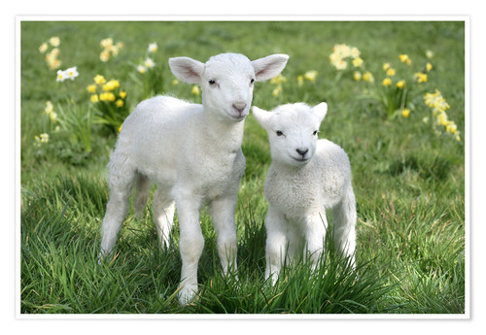
uain
Notes:
lambs

Slide 6
cnoc
Notes:
A hill

Slide 7
eaglais
Notes:
A church

Slide 8
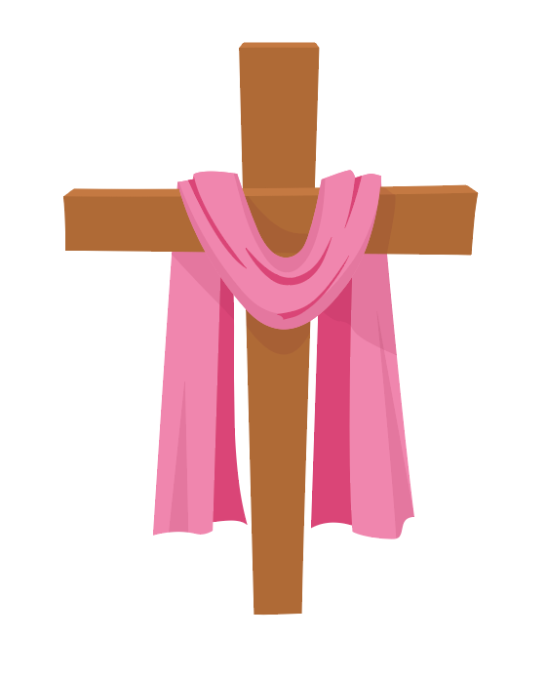
crois
Notes:
A cross

